Slide 1
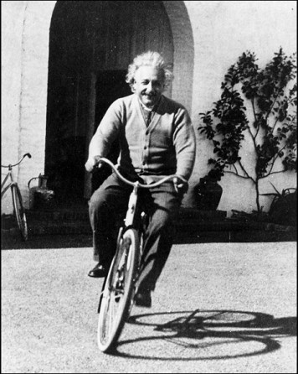
Classical Mechanics
PHYS2006
Tim Freegarde

Slide 2
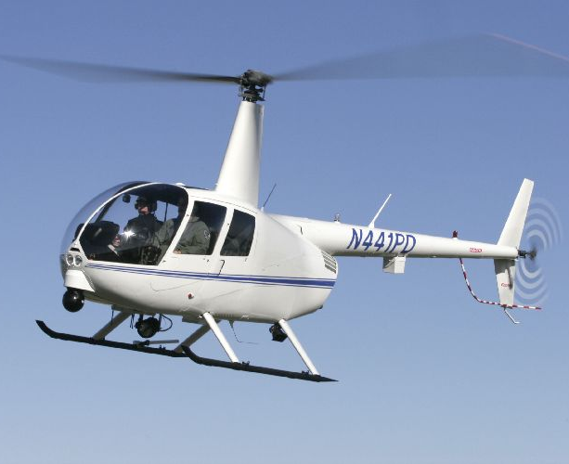
Helicopter dynamics
You are James Bond / Lara Croft / …
… and have seized a convenient helicopter in which to pursue your foe …
You push forward the control column to tilt the rotor forward and accelerate the aircraft
www.robinsonheli.com
What happens next ?

Slide 3
Bicycle dynamics
You are Victoria Pendleton / Chris Froome / …
Approaching a curve after a long straight run, you turn the handlebars a little to the right (clockwise when viewed from above)
Which way does the road curve?

Slide 4
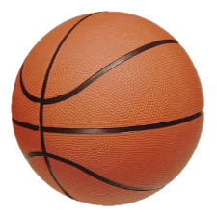
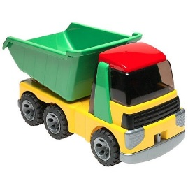
Inclined planes
You have two identical basketballs…
You place them side-by-side at the top of a smoothly sloping inclined plane.
One is placed directly on the inclined plane, the other is carried by a toy truck.
The two basketballs are released at the same instant.
Do they reach the bottom of the slope at the same time?

Slide 5
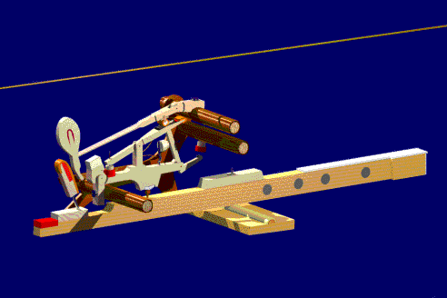
Pianoforte
The piano has two or three strings for each note
When a key is pressed, the hammer strikes these strings simultaneously
K Wayne Land www.musicresourcesusa.com
How does this give the instrument its characteristic sound?

Slide 6
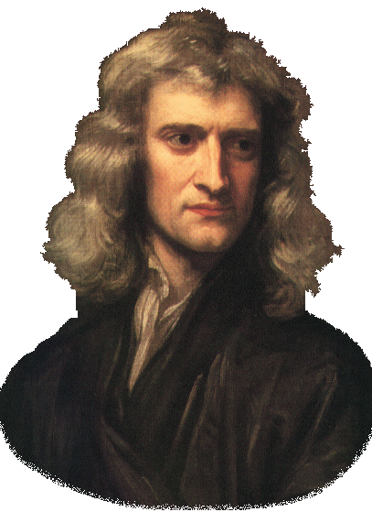
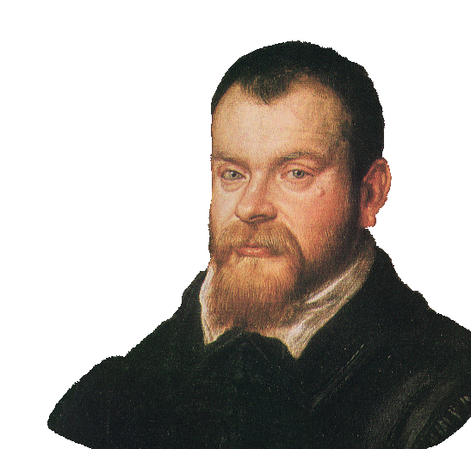
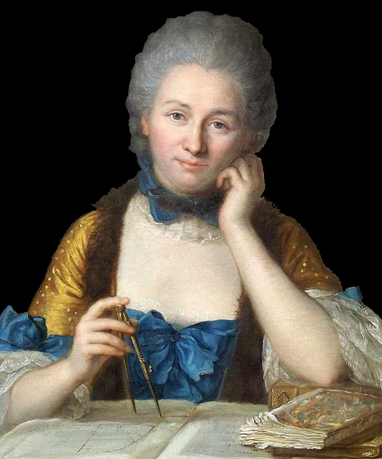
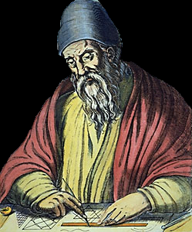
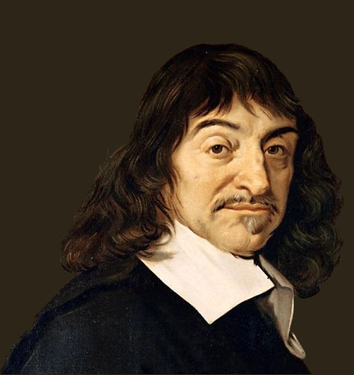
Principles of Classical Mechanics
Newton’s laws of motion (in an inertial frame)
a body continues in constant motion unless acted upon by an external force
an external force causes a proportional acceleration in inverse relation to the body’s mass
every action has an equal and opposite reaction
G Galilei, Discorsi e Dimostrazioni Matematiche Intorno a Due Nuove Scienze (1638)
I S Newton, Philosophiæ Naturalis Principia Mathematica (1687)
Principle of conservation of energy
Émilie du Châtelet, Principes mathématiques de la philosophie naturelle (1759)
Properties of Euclidean space
Euclid of Alexandria, Στοιχεῖα (c300 BC)
R Decartes, La Géométrie (1637)

Slide 7
Classical Mechanics
centre of mass
LINEAR MOTION OF SYSTEMS OF PARTICLES
Newton’s 2nd law for bodies (internal forces cancel)
rocket motion
rotations and infinitessimal rotations
ANGULAR MOTION
angular velocity vector, angular momentum, torque
parallel and perpendicular axis theorems
rigid body rotation, moment of inertia, precession
conservative forces, law of universal gravitation
GRAVITATION & KEPLER’S LAWS
2-body problem, reduced mass
planetary orbits, Kepler’s laws
energy, effective potential
NON-INERTIAL REFERENCE FRAMES
centrifugal and Coriolis terms
Foucault’s pendulum, weather patterns
NORMAL MODES
coupled oscillators, normal modes
boundary conditions, Eigenfrequencies

Slide 8
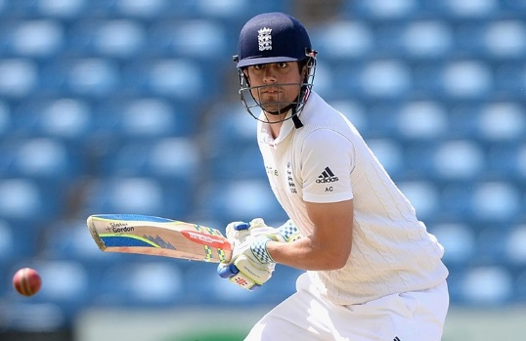
Classical Mechanics
LECTURES
1 single + 1 double lecture each week
lecture notes and directed reading
CLASSES
once a week (Friday 4pm)
identify difficulties beforehand!
COURSEWORK
weekly sheets of exercises
20%
hand in on level 3
EXAMINATION
a: 5 short questions
80%
b: 2 longer questions
formal analysis of rigid body dynamics
rockets, planets, plate tectonics, cricket bats, bicycles, weather, gyrocompass, piano
Newton’s laws, Kepler’s laws, gravitation, Coriolis, Foucault
normal modes, Eigen-frequencies, Hamiltonian, Lagrangian

Slide 9
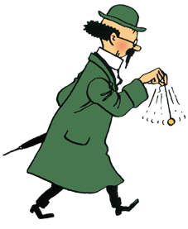
MPhys/BSc second year
more independent approach to study:
weekly coursework with longer, structured questions
formal working and derivations expected – care with vectors, units etc.
hand-written solutions and hand-drawn diagrams expected
weekly problem classes replace tutorials
variety of sources: lectures, notes, directed reading, own literature research
coursework sample marked; full model solutions provided
Albert Ross
2718282
✓
✗
✗
✗
+
✓
✓
More formal derivations, please
ﬁ
✓
✗
✗
✓
✓
✓
✓
Assumptions much better!
₧

Slide 10
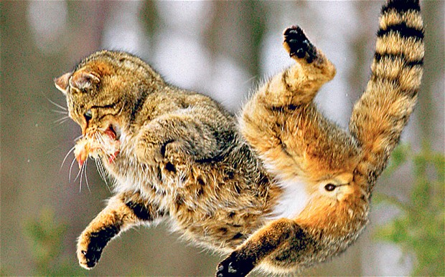
Classical Mechanics resources
You should expect to make use of:
lectures, hand-outs and your own lecture notes
textbooks - some suggestions in following slide
exercises and classes:
SUN
MON
TUES
WED
THUR
FRI
SAT
week n
EXERCISE SHEET
ON WEBSITE
week n+1
HAND IN
week n+2
for handouts, links and other material, see http://phyweb.phys.soton.ac.uk/quantum/phys2006.htm

Slide 11
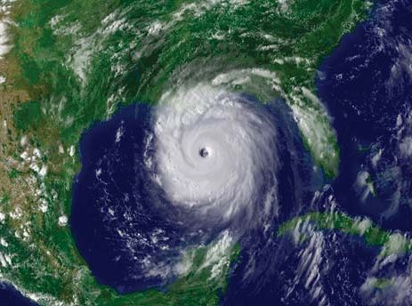
Classical Mechanics ‘feedback’
To help you assess your progress and improve:
weekly coursework will be returned with marks and comments
weekly problems classes offer individual help
tutors can give additional help
some past exam papers have model answers
lecturer ‘at home’: Tuesdays 4:00-5:00
email me!
for handouts, links and other material, see http://phyweb.phys.soton.ac.uk/quantum/phys2006.htm

Slide 12
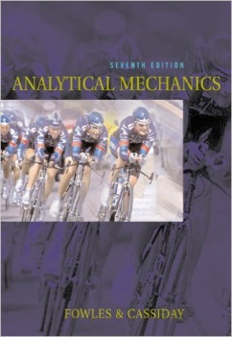
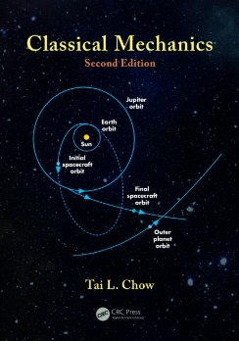
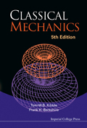
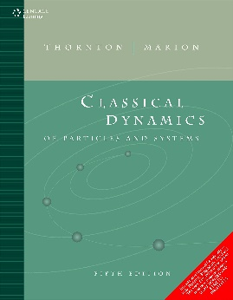
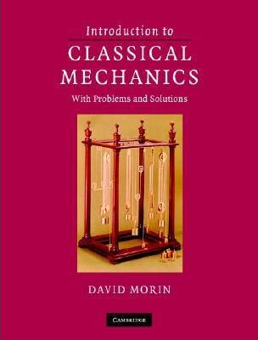
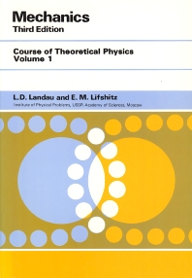
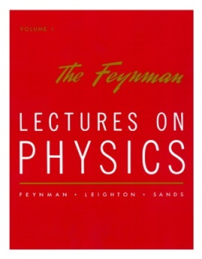
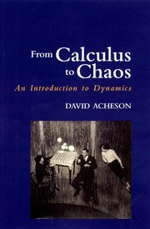
Textbooks
Fowles & Cassiday
Analytical Mechanics
good: right level comprehensive on rigid-body dynamics; fine examples
Chow
Classical Mechanics
good: right approach; concise
French & Ebison
Introduction to Classical Mechanics
quite good: right level, well paced
Kibble & Berkshire
Classical Mechanics
good, concise
Marion & Thornton
Morin
Intro to Class Mech
Classical Dynamics
more advanced
looks good, concise
Landau & Lifshitz
Mechanics
classic theoretical approach
Feynman
Lectures on Physics
excellent introduction: put on your Christmas list!
Acheson
From Calculus to Chaos
inspiring, supplementary reading

Slide 13
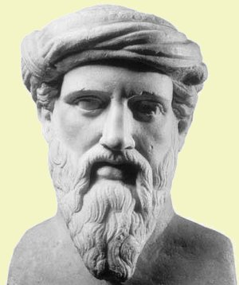
Pythagoras’ theorem
Pythagoras of Samos (c570-495 BC)
Relies upon properties of Euclidean space

Slide 14
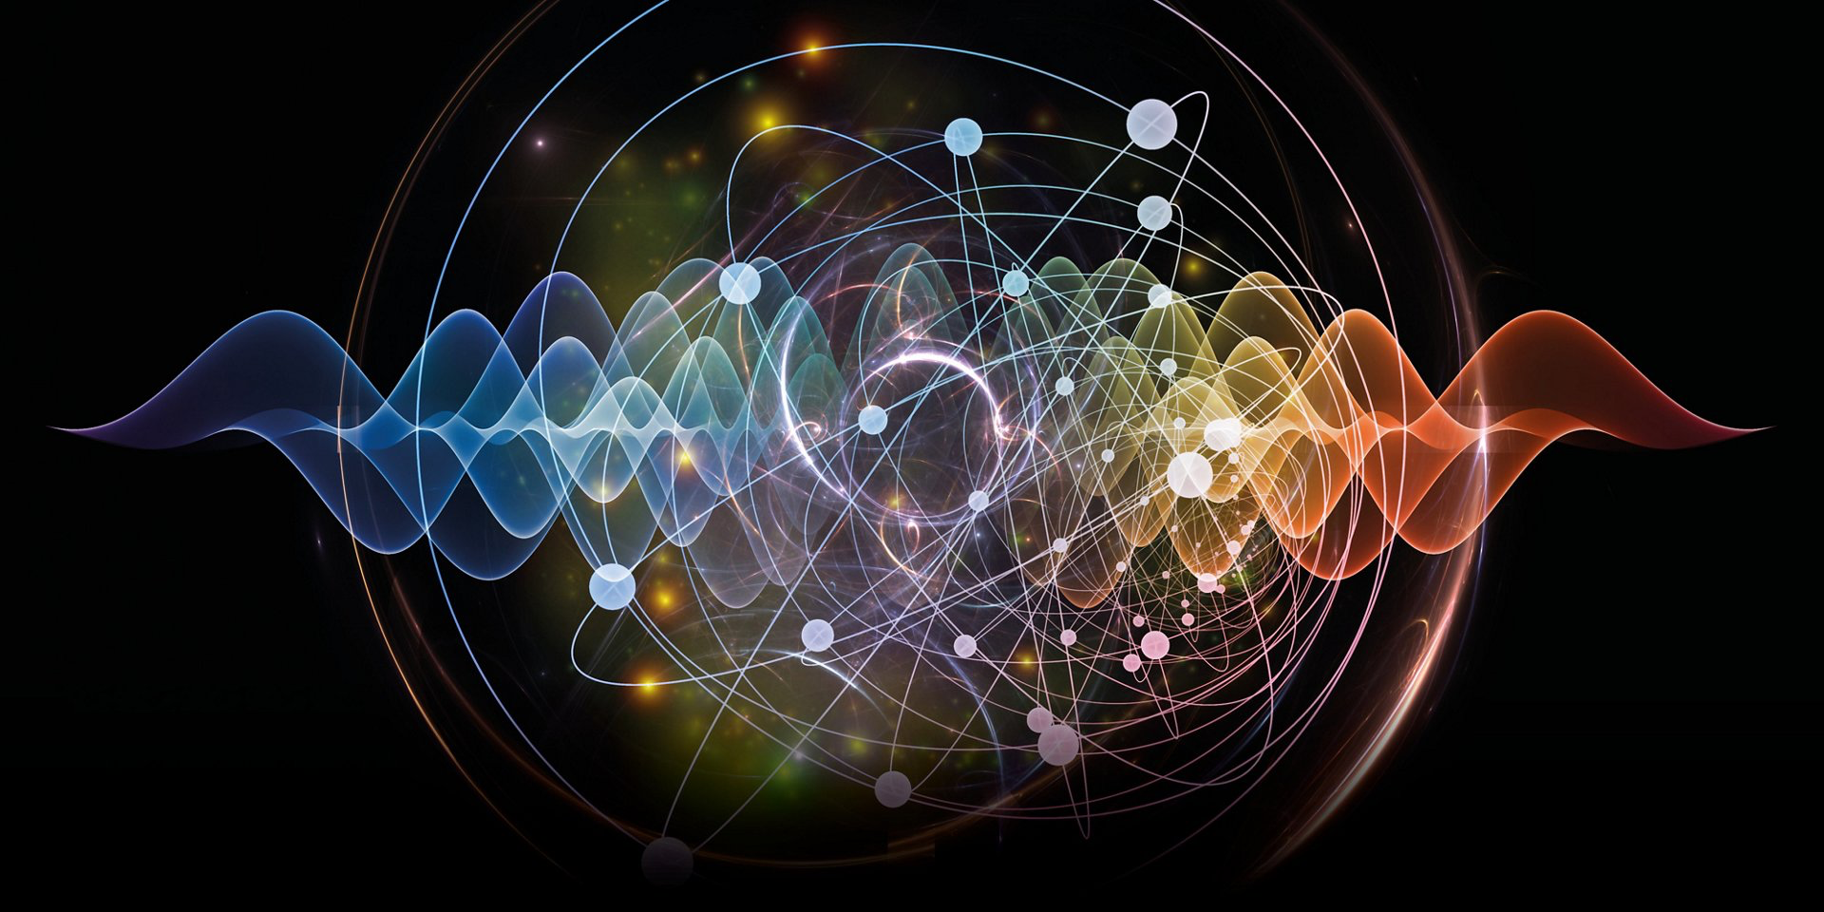
Join flagship programme: MPhys with year in experimental research Positions are still open for experimental projects to start in October 2020 (or later)
Projects are hosted by the QLM group
at P&A and research topics include:
Single photons and squeezed light
Quantum theory
Solid-state theory
Polaritonics
Nanomaterials for biomedical applications
X-ray diffraction and imaging
Cold atoms
Nano-optics and plasmonics
Optomechanics
THz spectroscopy and semiconductor lasers
Raman and ultra-fast spectroscopy
2d materials
Liquid crystal materials and analysis
Matterwave interferometry
Fundamental physics on the table top
Who can join?
You are excited about experimental
or theoretical research within the
Quantum, Light and Matter research
group. You have an average mark of
not less than 70.
Research project condition:
You will spend the entire 4th year of
studies on an exclusive Physics
research project.
Please get in contact asap:
Professor Hendrik Ulbricht
Quantum, Light and Matter
h.ulbricht@soton.ac.uk
room: 46/5011

